Slide 1
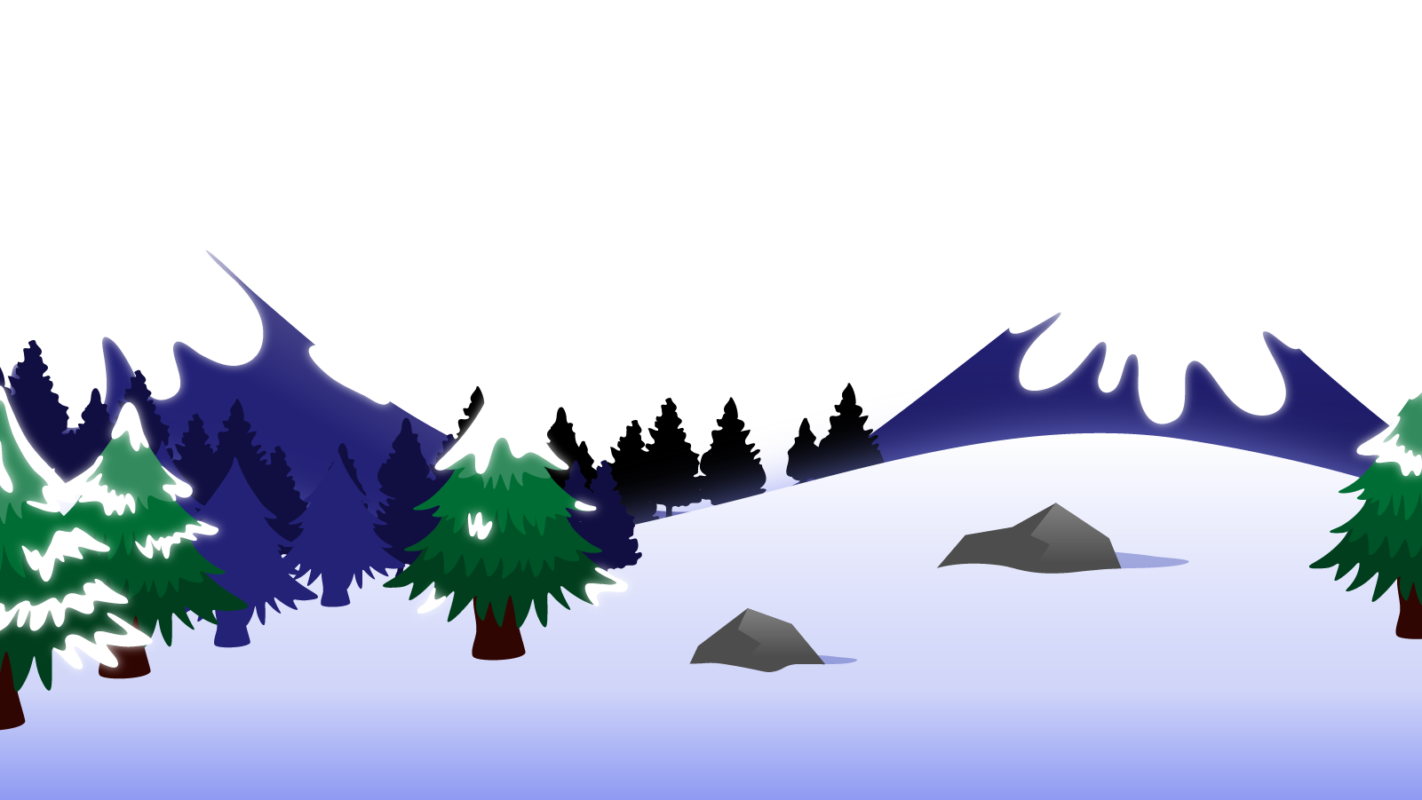
How to Use this Powerpoint
These slides have been designed to be used in Powerpoint as a Slide Show.
There are text and images that will overlap and cause confusion, if used in desktop mode.
To open this in Slide Show mode, please click “Slide Show” on the menu above and then “From Beginning”.
Thank you from the Emile Team.
If you have any feedback, or would just like to say “hello”, please email us at: hello@emile-education.com

Slide 2
Noun Phrases

Slide 3
Does anyone remember what a noun is?
A noun is a thing or an object.
Can you think of
any examples of nouns?

Slide 4
These words are ALL nouns.
table
Monday
bravery
pride of lions
chair
England
loneliness
pack of lies
room
December
courage
school of fish
brother
London
sadness
gaggle of geese
teacher
Emile
happiness
army of ants
Nouns can be quite dull and uninteresting.

Slide 5
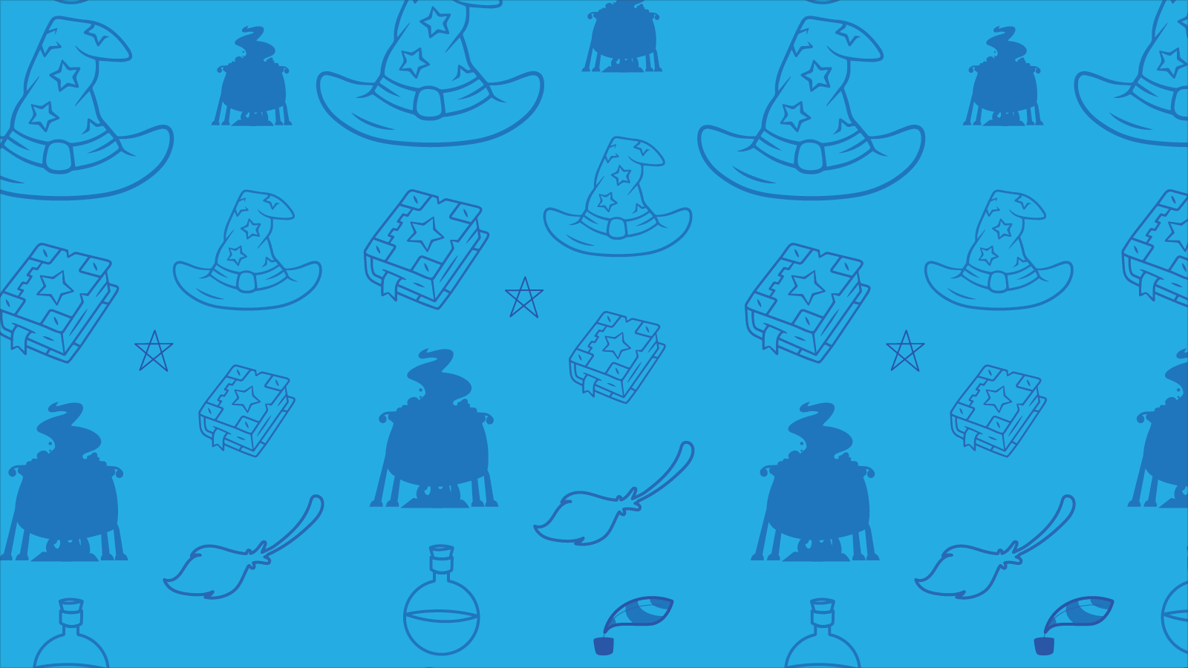
Which of these words are nouns?
shoots - verb
student - noun
shoots
student
listen
computer - noun
listen - verb
computer
TV - noun
TV
like - verb
like
girl
girl - noun
boy- noun
boy
courage
sea - noun
courage - noun
sea
learn
learn - verb
collect - verb
collect
brother
brother - noun
London
Aimee
London - noun
Aimee - noun
whiteboard- noun
whiteboard
confidence - noun
teacher
Emile
confidence
teacher - noun
Emile - noun
army of ants
army of ants - noun

Slide 6
Can you spot the nouns in this sentence?
Can you spot two things in this sentence?
Some doctors work in hospitals.
The word “doctors” is a noun.
The word “hospitals” is a noun.
Nurses like to help people.
The word “nurses” is a noun.
The word “people” is a noun.

Slide 7
Does anyone know what an adjective is?
An adjective is a word that describes a noun.
Can you think of any
examples of adjectives?

Slide 8
These words are ALL adjectives.
brave
few
flat
American
happy
some
round
French
short
many
spherical
English
heavy
young
red
wood
fast
old
blue
metal
Adjectives make nouns more interesting!

Slide 9
Does anyone remember what a determiner is?
A determiner comes before a noun and gives information about the noun.
Can you think of any
examples of determiners?

Slide 10
Some examples of determiners are:
a
this
my
some
one
an
that
her
many
two
the
those
his
few
three

Slide 11
Does anyone know what a noun phrase is?
A noun phrase is a group of words that act as a noun.
It usually is made up of:
a determiner,
at least one adjective and
a noun.
Can you think of any
examples of adjectives?
An old brown dog

Slide 12
A noun phrase
Which word is a determiner?
Which words are adjectives?
Which word is the noun?
The word “An” is a determiner.
The word “dog” is a noun.
An old brown dog
The words “old” and “brown” are adjectives.

Slide 13
A noun phrase
Which word is a determiner?
Which words are adjectives?
Which word is the noun?
The word “The” is a determiner.
The word “troll” is a noun.
The angry huge troll.
The words “angry” and “huge” are adjectives.

Slide 14
A noun phrase
Which word is a determiner?
Which words are adjectives?
Which word is the noun?
The word “A” is a determiner.
The words “few” and “broken” are adjectives.
A few broken windows.
The word “windows” is a noun.

Slide 15
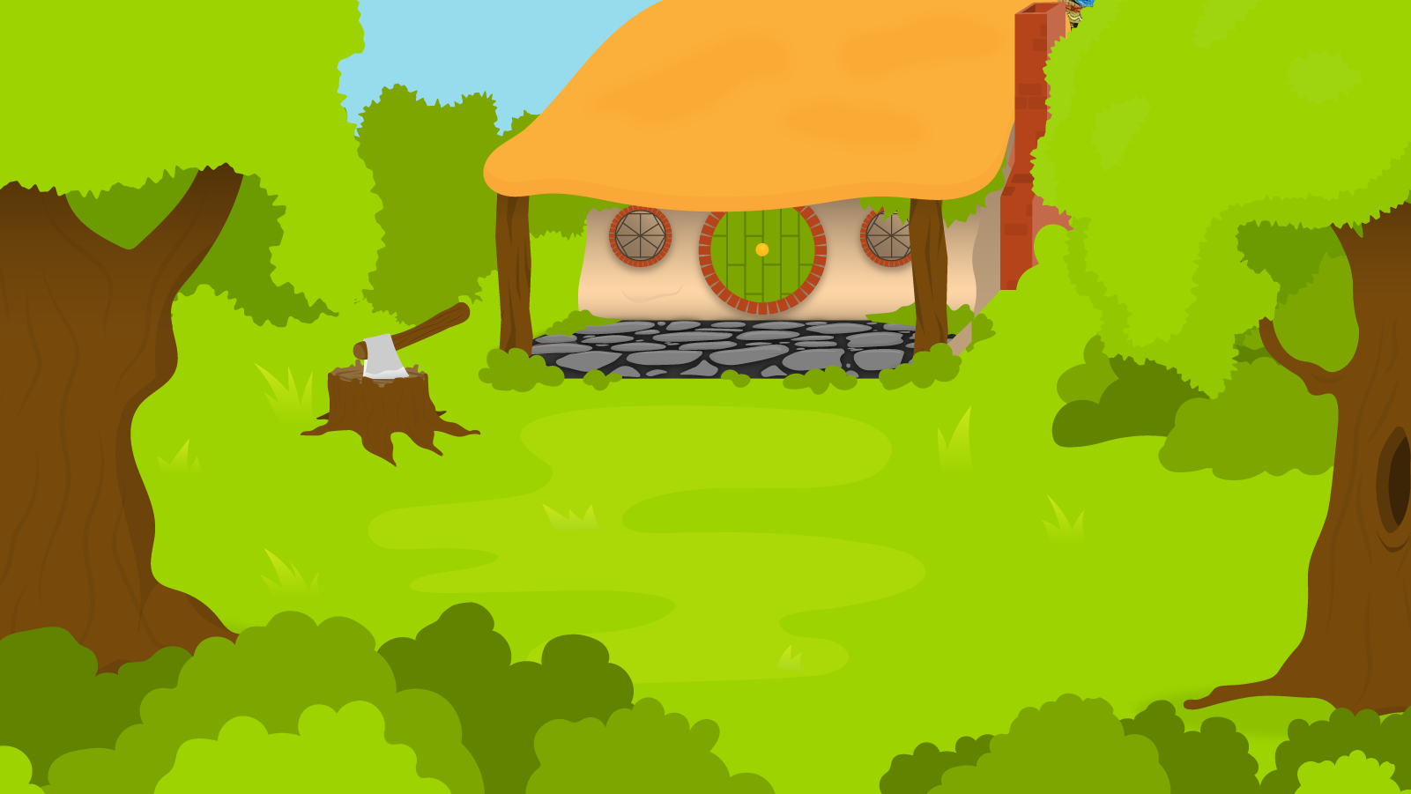
Below are 3 nouns. You have 1 minute to turn these nouns into noun phrases!
1 Minute Timer
Time’s Up!
GO!
1. Dogs.
2. Tables.
3. Tools.
GO!
Last 15 seconds!
TIME’S UP!
Start

Slide 16
How about?
1 Minute Timer
1. A few yappy happy dogs
2. The old grey tables.
3. The expensive power tools.
TIME’S UP!

